Slide 1


SMART INDIA HACKATHON 2025
Problem Statement ID – 25093
Problem Statement Title- Centralised Digital platform for Comprehensive student activity record in HEIs.
Theme- Smart Education
PS Category- Software
Team ID-
Team Name- Yuva Innovators

Slide 2
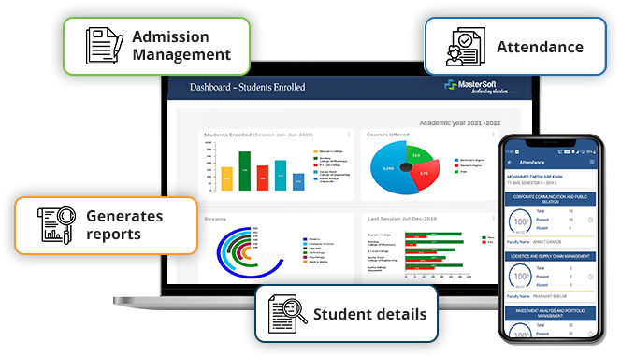
Centralised Digital platform for Comprehensive student activity record in HEIs
Yuva Innovators
Proposed Solution
Solution Explanation
Centralized web + mobile application for student achievements
Dynamic Dashboard
Digital Portfolio
Activity Tracker
Reports for NAAC/NIRF/AICTE
Addressing the Problem
Reduces administrative burden and facilitates audit compliance
Provides transparent, real-time progress tracking
Ensures verified, credible, and holistic student profiles
Supports placements,higher education applications and scholarships
Innovation and uniqueness
Holistic Record-Keeping
Verified Auto-Generated Portfolio
Web + Mobile Access:Anywhere , anytime accessibility

Slide 3
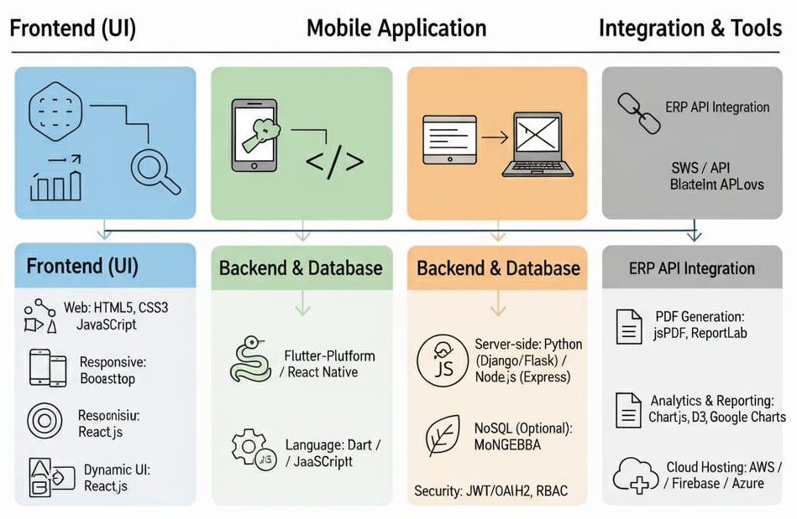
TECHNICAL APPROACH
Yuva Innovators
Frontend (UI):
Web: HTML5, CSS3, JavaScript
Responsive Frameworks: Bootstrap
Dynamic UI: React.js
Mobile Application:
Cross-Platform: Flutter / React Native
Languages: Dart (Flutter) / JavaScript (React Native)
Backend & Database:
Server-side Languages: Python (Django / Flask) or Node.js (Express)
Relational Database: MySQL / PostgreSQL
Optional NoSQL Database: MongoDB (flexible activity storage)
Security: JWT / OAuth 2.0, Role-based Access Control
Integration & Tools:
ERP API integration
PDF Generation: jsPDF, ReportLab
Analytics & Reporting: Chart.js, D3.js, Google Charts
Cloud Hosting: AWS / Firebase / Azure

Slide 4
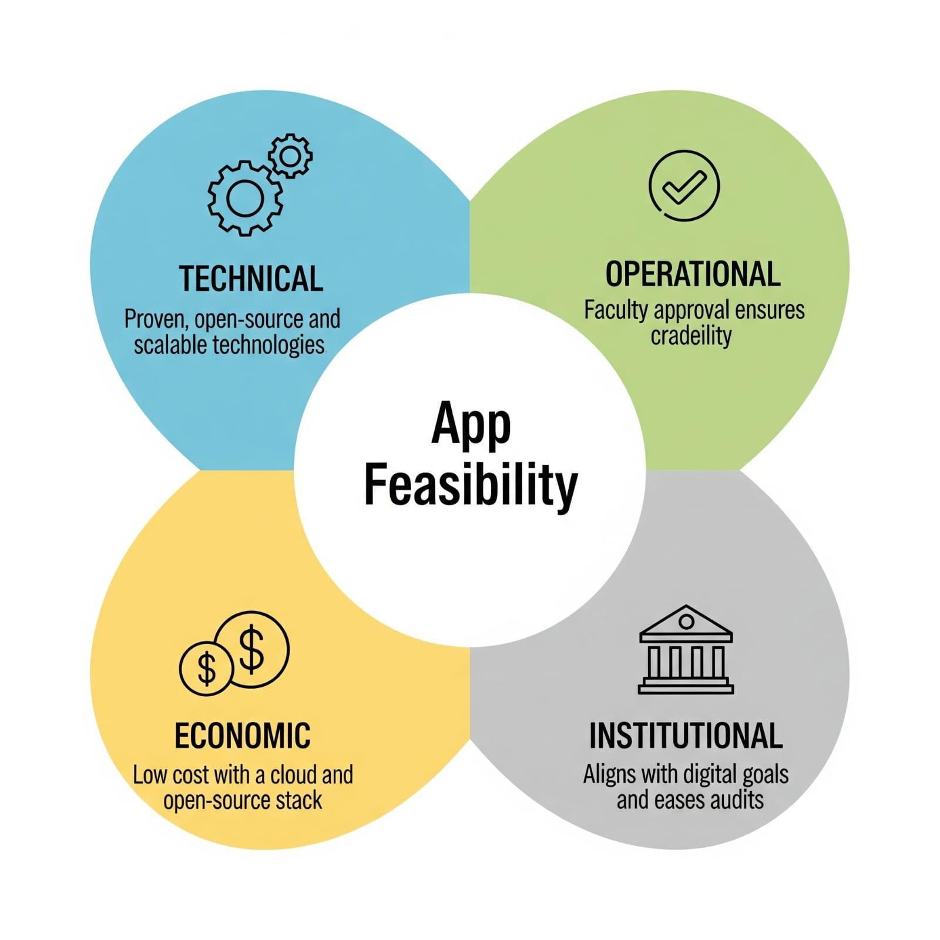
FEASIBILITY AND VIABILITY
Yuva Innovators
Feasibility
Technical: Uses proven, open-source, scalable technologies
Operational:Faculty approval ensures credibility of achievements
Economic: Low cost (cloud + open-source stack)
Institutional:Aligns with NAAC/NIRF digital goals, eases accreditation audits
Potential Challenges:
Fake/Unverified data uploads
Integration complexity with ERP
Resistance to new system adoption
Large-scale scalability issue
Strategies to Overcome:
Faculty/Admin approval + API verification of certificates
Standard APIs & phase-wise integration
Training workshops + user-friendly dashboards + gamification
Strong data security

Slide 5
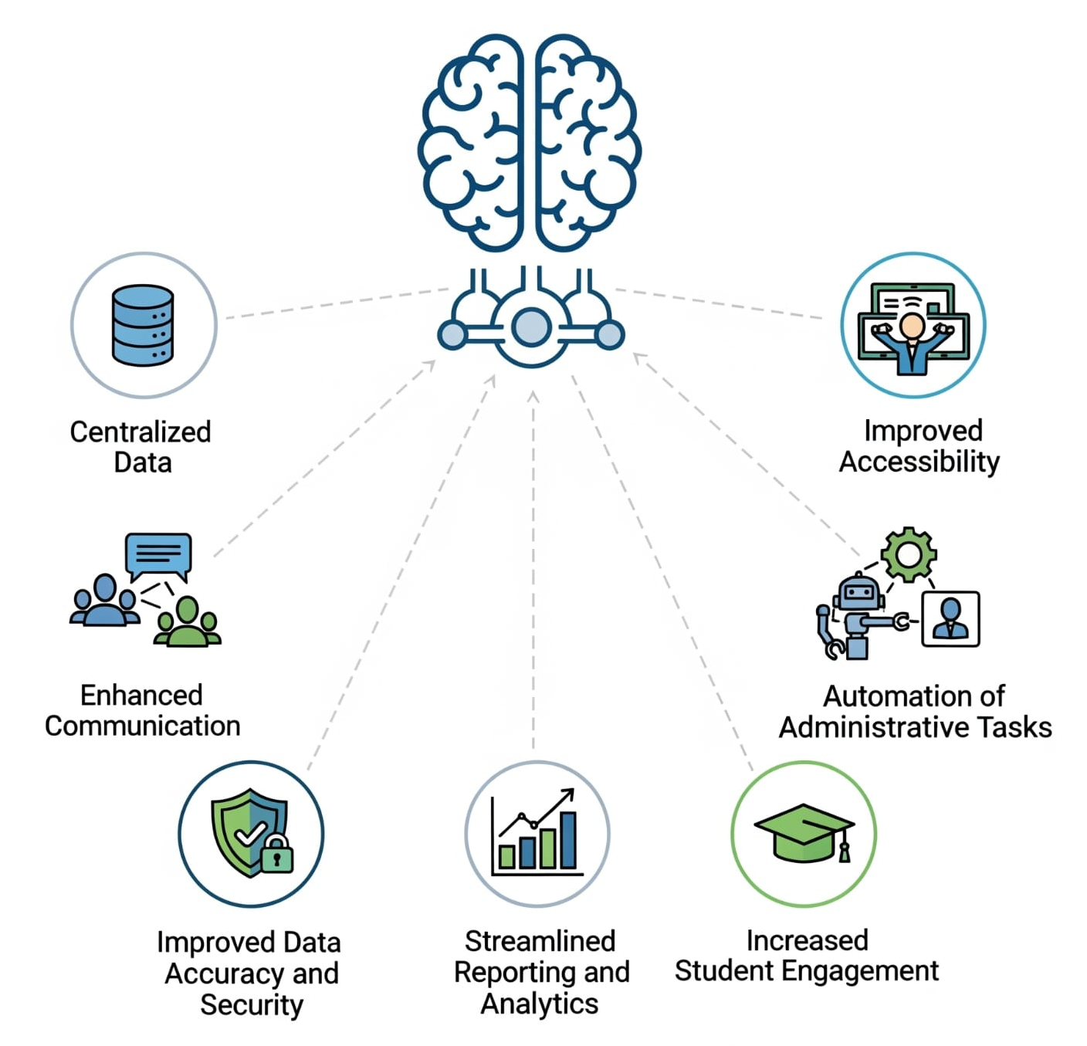
IMPACT AND BENEFITS
Yuva Innovators
Impact on Institutions Benefits for institutions
Cost and time Saving Centralised Data Hub
Data-Driven Governance Seamless Accrediation Support
Seamless Integration Reduced Paperwork
Institution Branding Faculty Empowerment
Impact on Students Benefits for Students
Holistic Digital Identity Verified Digital Portfolio
Career Edge One-Stop Access
Motivation/Engagement Career Boost
Equity and Inclusivity Transparency

Slide 6
RESEARCH AND REFERENCES
Yuva Innovators
NEP 2020 (India) – Focus on digital records & holistic development.
[https://www.education.gov.in/nep/]
Digital India Initiative – Push for connected, paperless systems.
[https://www.digitalindia.gov.in]
NIRF & NAAC–Emphasize student performance data. [https://www.nirfindia.org | https://www.naac.gov.in]
World Bank–EdTech improves employability & efficiency. [https://www.worldbank.org/en/topic/edutech]
Case Studies:
DigiLocker(India)-Verified digital certificates and credentials.
NAD(India)-National Academic Depository for academic records.
Europass(EU)-Unified student portfolio and skill recognition system.

